Slide 1

2023 lprf Application
PROJECT PROPOSAL PRESENTATION
Richland Park – Splashpad, Restrooms, and Parking Lot Development
Dogwood Hills Municipal Golf Course – Irrigation Replacement

Slide 2
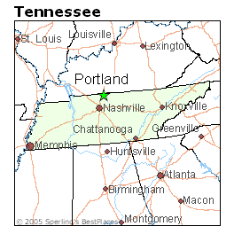
Census Population 2021 American community survey estimates
City of Portland
Total Population: 13,031
Total Households: 4,688
Sumner County
Total Population: 200,557
Total Households: 77,760
The City of Portland is located in Sumner County
https://censusreporter.org/profiles/16000US4760280-portland-tn/

Slide 3
RECREATIONAL ACREAGE
The City of Portland has nearly
298 acres
of land dedicated to recreational use

Slide 4
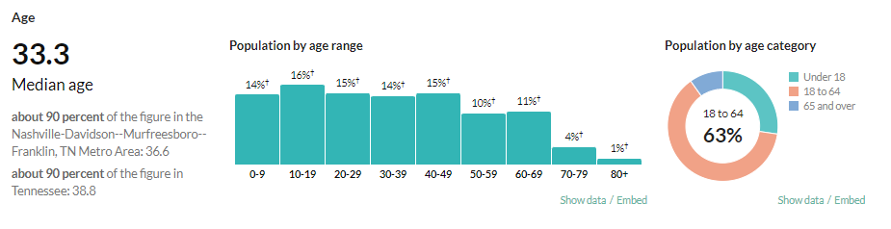
Target Demographics
Proposed improvements at both parks will continue to make the recreational facilities available to all persons, regardless of age, gender, race, economic status, or possible disability.
The proposed improvements and upgraded facilities can be used by all ages.

Slide 5
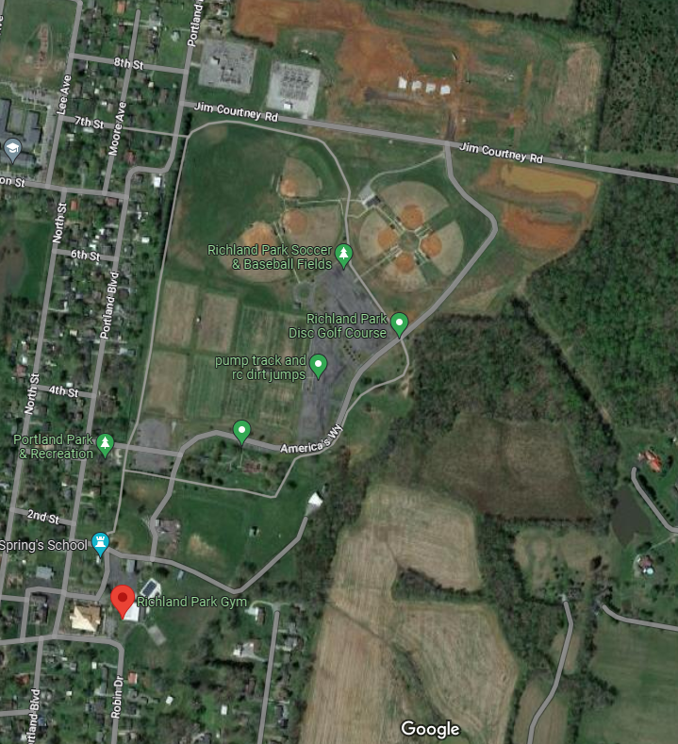
Public Recreation Activities/ Programs Envisioned at Richland Park
Proposed:
Splashpad
Existing:
Walking/Hiking, Swimming, Picnicking, Mountain Biking, Concerts, Disc Golfing, and Basketball, Soccer, Baseball, Softball, and Football Games

Slide 6
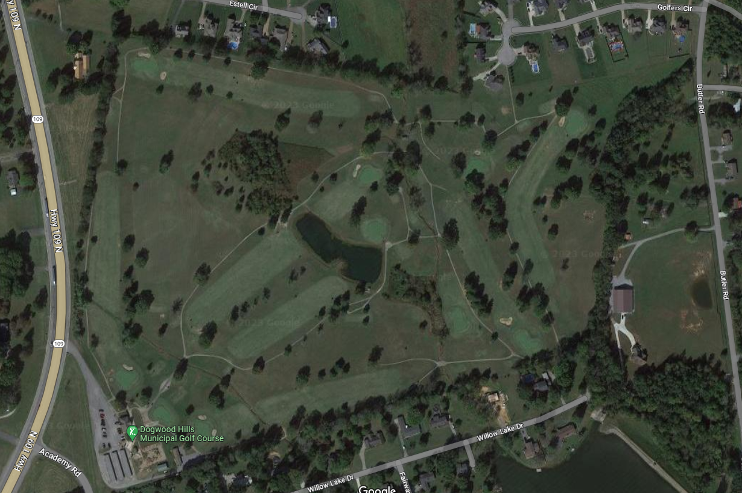
Public Recreation Activities/ Programs Envisioned at Dogwood hills golf course
Proposed:
Golfing & Golf Tournaments
Existing:
Golfing & Golf Tournaments

Slide 7
Positive Community Impact
Addresses the needs, interests, and priorities of the community detailed during the 2022 Parks & Recreation Master Planning process.
Improve public health by encouraging outdoor physical activity
Additional Amenities at Richland Park
Construction of a Splashpad
Parking and restrooms are essential support amenities
Improve Irrigation System at the Golf Course

Slide 8
Goal of Project
Address the public’s wishes, needs, and priorities as outlined in the 2022 System-Wide Parks & Recreation Master Plan
Expand utility of Richland Park with the addition of new amenities
Replace inadequate and aging irrigation infrastructure at Dogwood Hills Golf Course

Slide 9
Means & Funding For Development
Cash as match from the Portland Parks and Recreation Department Budget

Slide 10
Suitability, Location, & Topography for Development of Project
Located within the existing Richland Park and Dogwood Hills Golf Course
Near residential areas
Improvements will take place on previously developed portions of the property
ADA accessibility will be considered in the design for at Richland Park. Dogwood Hills should have adequate ADA accommodations and the irrigation improvements will not affect ADA accessibility.

Slide 11
Site Development
The proposed project addresses park needs identified in the 2022 Master Plan
Add amenities at Richland Park
Construct a Splashpad
Improve Irrigation at the Golf Course
Future Site Development
Richland Park – New Maintenance Building, Parking Improvements, Playground Improvements
Dogwood Hills – New Cart Shed, Signage Improvements, and Parking Improvements

Slide 12
Programming Plans for Site
Richland Park
Dogwood Hills
Proposed:
Open Water Plan
Existing:
Walking/Hiking, Swimming, Picnicking, Mountain Biking, Concerts, Disc Golfing, and Basketball, Soccer, Baseball, Softball, and Football Games
Proposed:
Golfing
Golf Tournaments
Existing:
Golfing
Golf Tournaments

Slide 13
State Comprehensive Recreation Plan Goal: Advocacy & Education
The City of Portland advocates for parks and recreation by pursing projects that improve connectivity and access. The addition of a splashpad will allow a more children to participate in physical activity and family connect within the community. Future plans for the splashpad development include connections to the walking trail and other amenities at Richland Park.
The proposed irrigation replacement will improve the irrigation at Dogwood Hills Golf Course, which improves the educational environment and utility of the site.

Slide 14
State Comprehensive Recreation Plan Goal: Collaboration & Partnerships for Economic Success
The City of Portland mapped and inventoried their recreation system in 2022 with the development of the Parks and Recreation Master Plan. This has helped prioritize the community’s needs. The City recognizes that quality parks and recreation amenities are a critical component to improving quality of life, which influence the attraction of new residents and maintaining existing residents. Both residents and businesses are important to the economic success of communities like Portland. The splashpad and golf course will draw in residents from surrounding areas, providing an opportunity for more sales tax revenue.

Slide 15
State Comprehensive Recreation Plan Goal: conservation
The City of Portland is committed to conservation of parks and recreational facilities. This is exhibited by the City’s pledge to maintenance and growth in the annual budget. Funding maintenance keeps the parks and amenities in good and useful condition. Park space allows for preservation of trees and open areas to be used by the public. The proposed irrigation improvements will help improve the green space and trees at the Golf Course. Both sites will conserve land for the use of parks and recreation through a Notice of Limitation of Use that will be placed on the properties.

Slide 16
State Comprehensive Recreation Plan Goal: inclusivity, diversity, equity, access, affordability
The proposed splashpad will be ADA accessible. It creates a place where all can play together allows children to encounter people who are different than them in a safe and fun environment. Having a municipal golf course makes golfing more readably accessible and affordable to the public, making the sport more inclusive, diverse, and equitable. Applying for LPRF funds will allow the City to stretch the parks and recreation budget further.

Slide 17
3 Year Project Timeline
Apr. 2023
Submit Application
Oct. 2023
Receive Funding Award
Dec. 2023 – Feb. 2024
Environmental Review
May 2024
State Contracting
July–Oct. 2024
Project Design
Dec. 2024 – Feb. 2025
Bidding & Award
Apr.–Oct. 2025
Construction
Jan. 2026
Project Close-out

Slide 18
Project Design Elements
Use of Site
The proposed splashpad will expand and increase utility of the amenities of Richland Park.
The proposed restroom and parking will support the new splashpad.
The irrigation improvements at Dogwood Hills Golf Course will improve the conditions and utility of the course.

Slide 19
Project Design Elements
Access
The parks are open to citizens between sunrise and sunset
Ease of Maintenance
The City of Portland has successfully developed and maintained Richland Park for many decades.
The City took over Dogwood Hills in 2018, and the new irrigation will improve the maintenance of the course.
The proposed project activities will not create any new routine operational maintenance responsibilities for the maintenance staff.

Slide 20
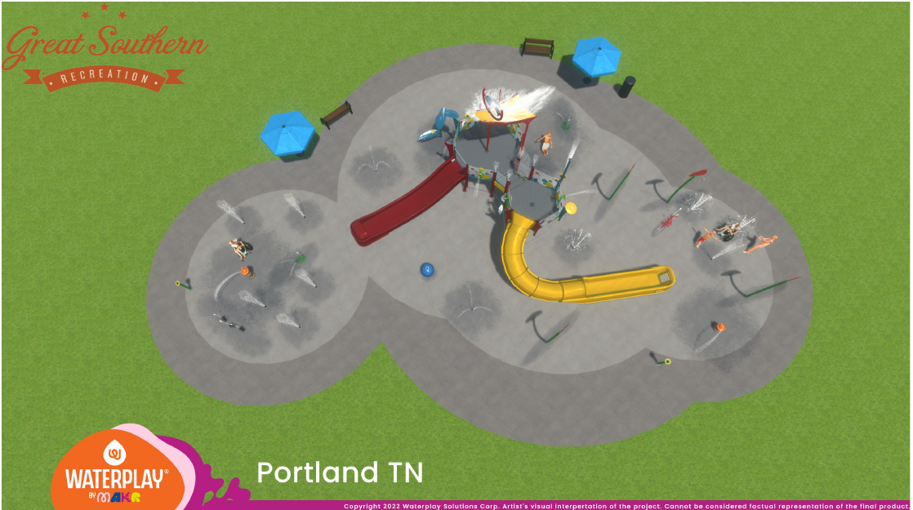
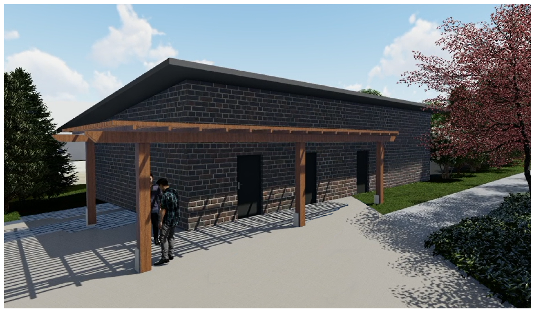
Pictures of SIMILAR DEVELOPMENT

Slide 21
Pictures of SIMILAR DEVELOPMENT

Slide 22
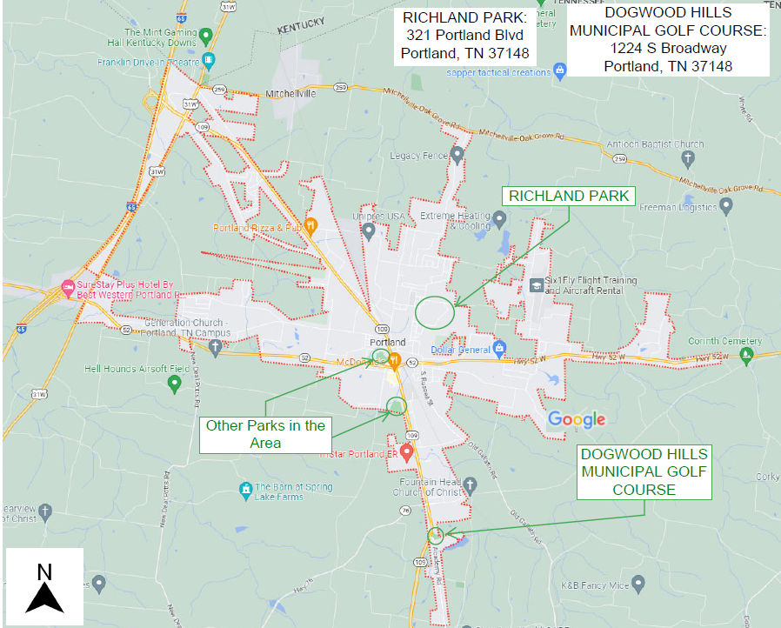
Project Location Map

Slide 23
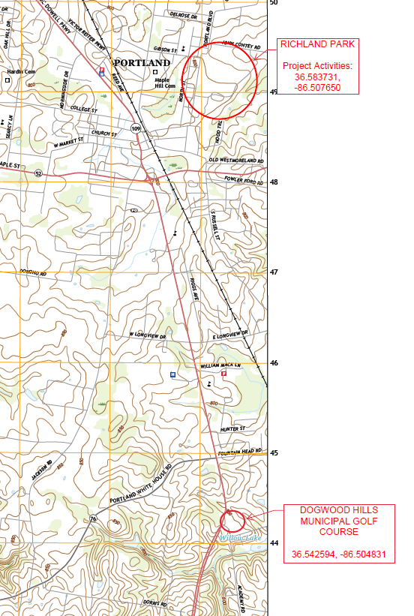
Topographic Map

Slide 24
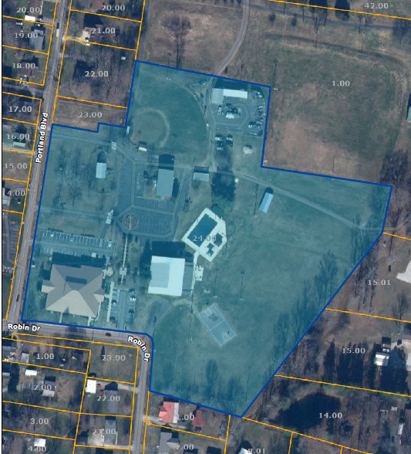
Project Boundary Map Richland Park

Slide 25
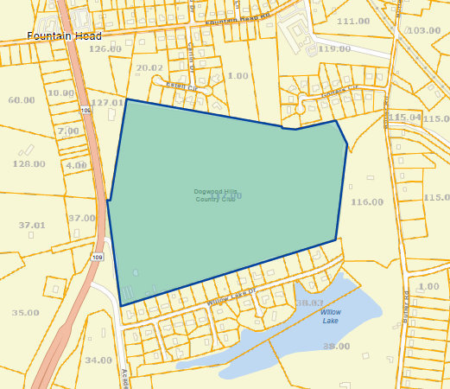
Project Boundary Map Dogwood hills municipal golf course

Slide 26
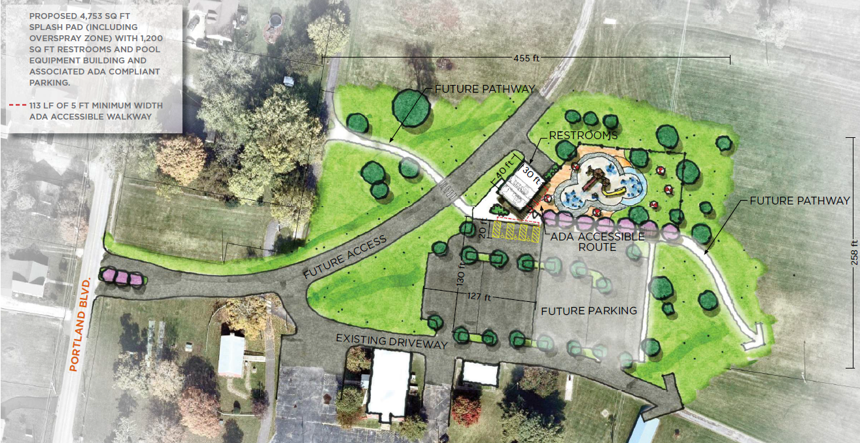
Preliminary Site Plan richland park

Slide 27
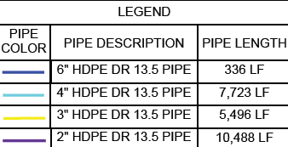
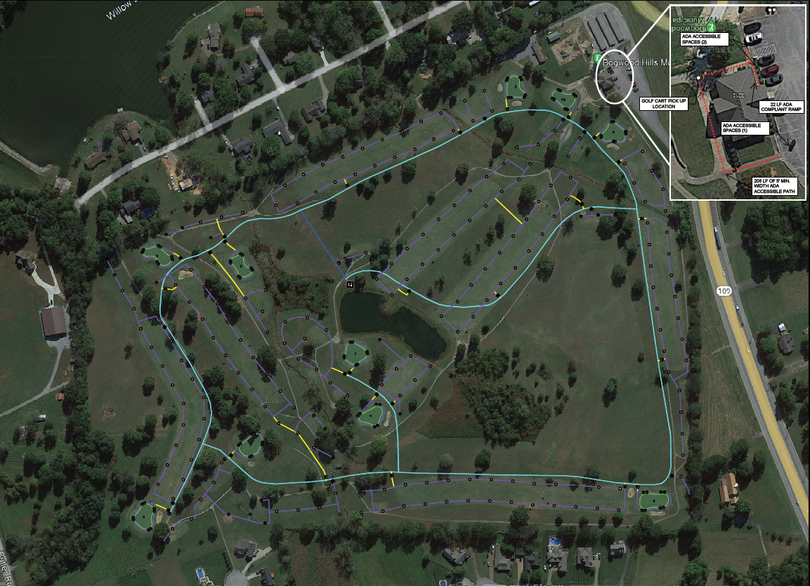
Preliminary Site Plan Dogwood hills municipal golf course

Slide 28
Thank You For Considering Our Project!

